Slide 1

The Struggle for the Constitution

Slide 2
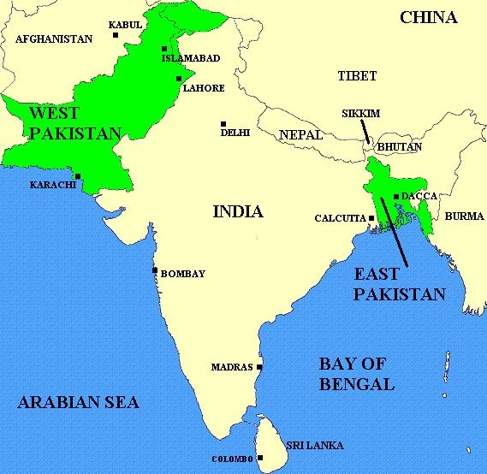

Slide 3
After Partition, the government of Pakistan is headed by Muhammad Ali Jinnah as Governor-General, with Liaquat Ali Khan serving as Prime Minister. A constituent assembly is formed to act as both parliament and to draft a constitution.
The British imperial government granted independence through the enactment of the Indian Independence Act, 1947. Under the Act, the British Crown relinquished its sovereign powers over India and transferred those powers to the newly established dominions of Pakistan and India on 14 August and 15 August 1947 respectively.
The Government of India Act, 1935 was amended to bring it in consonance with the aims and objectives of independence as laid down in the 1947 Act.
The combination of these two constitutional instruments served as an interim constitutional order for both India and Pakistan until their respective constituent assemblies adopted their own constitutions.
Sir Frederick Chalmers Bourne was appointed as Governor of East Bengal and Khawaja Nazimudin of the Muslim League (ML) was appointed as Chief Minister of the Province of East Bengal on August 14, 1947.

Slide 4
Governor-General and President of the Pakistan Constituent Assembly Muhammad Ali Jinnah declared that Urdu would be the only official language of Pakistan during a speech in Dhaka (Dacca), East Pakistan on March 24, 1948.
Jinnah died on September 11, 1948.
Chief Minister Khwaja Nazimuddin took over as Governor-General of Pakistan on September 14, 1948.
Nurul Amin of the ML was appointed as Chief Minister of East Bengal on September 15, 1948.

Slide 5
Objectives Resolution is one of the most important documents in the constitutional history of Pakistan.
It was passed by the first Constituent Assembly on 12th March 1949 under the leadership of Liaquat Ali Khan.
It laid down the objectives on which the future constitution of the country was to be based and it proved to be the foundational stone of the constitutional development in Pakistan.
It contained the basic principles of both Islamic political system and Western Democracy.

Slide 6
Sovereignty of the entire Universe belongs to Allah alone
Authority should be delegated to the State trough its people under the rules set by Allah
Constitution of Pakistan should be framed by the Constituent Assembly
State should exercise its powers through the chosen representatives
Principles of democracy, freedom, equality, tolerance and social justice, as ensured by Islam should be followed
Muslims shall live their lives according the teachings of Quran and Sunnah
Minorities can freely profess and practice their religion.
There should be Federal form of government with the maximum autonomy for the Units

Slide 7
Fundamental rights including equality of status, of opportunity and before law, social, economic and political justice, and freedom of thought, expression, belief, faith, worship and association, subject to law and public morality should be given to all the citizens of the state.
It would be the duty of the state to safeguard the interests of minorities, backward and depressed classes.
Independence of judiciary should be guaranteed
Integrity of the territory and sovereignty of the country was to be safeguarded.
The people of Pakistan may prosper and attain their rightful and honored place amongst the nations of the world and make their full contribution towards international peace and progress and happiness of humanity.

Slide 8
Religion and politics.
Minority rights
Role of Ulemas
Fundamental rights
State Language

Slide 9
Representation between East and West Pakistan in the federal legislature was the problem which, more than any other, delayed the framing of a constitution.
Pakistan consists of two parts separated by a thousand miles of foreign (Indian) territory.
East Pakistan is one-seventh of the whole in area, but its population exceeds the total population of all the provinces and states in West Pakistan.
In other words, Pakistan is a curiously dual state with most of its area in the West and most of its population in the East.

